Slide 1
Intro to Coding:
Output, Input and Variables
Elementary Coaches Academy

Slide 2
Log into your Scratch account
https://scratch.mit.edu

Slide 3

Warm up
Open the starter File
http://bit.ly/BYTEC1
Run the program by
clicking the flag icon
Flag Icon

Slide 4
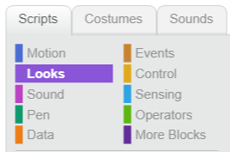
Warm up
Click the “Looks” menu
Add a command to make the cat say “Goodbye”

Slide 5
Warm up
Change the program to say:
Hello [your name]!

Slide 6

Lab Lecture
Click the “sensing” menu
Add a question to your program

Slide 7
Definition:
Output
A way to get information out of a computer.
What examples of output did we see in this program?

Slide 8
Lab Lecture
Change your program so it:
Asks the user for their name
Prints “Hi there [name]”

Slide 9
Definition:
Input
A way to give information to a computer.
What examples of input did we see in this program?

Slide 10
Lab Lecture
What if you want to:
Ask for the user’s first name, then ask for their last name and say:
“Hi Ada Lovelace!”
Notes:
Show them how to create a variable in the data menu

Slide 11
Definition:
Variable
A placeholder for a piece of information that can change.
What was the changing information in our program?

Slide 12

Practice
Exercises are divided into sections listed below.
Set a timer for 30 minutes.
Choose your comfort level and continue working to complete as much as possible.
When the time is up, submit your project link for each section you attempted.
LINK
Mild
Medium
Spicy
perfect for beginners
expanding your skills?
looking for a challenge?

